Slide 1
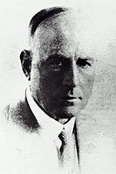
How it all started?
Frederick Griffith (1879–1941) was a British bacteriologist.
1928- studies on pneumonia by infection in mice

Slide 2
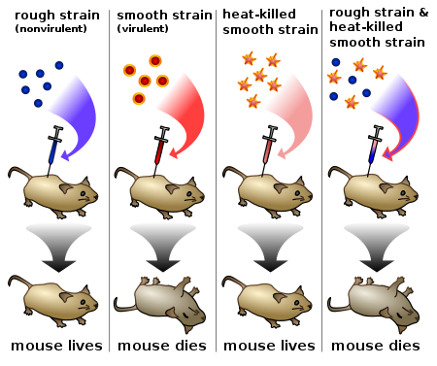
Griffith’s Experiment

Slide 3
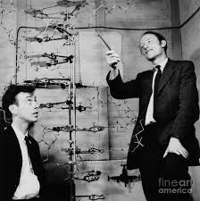
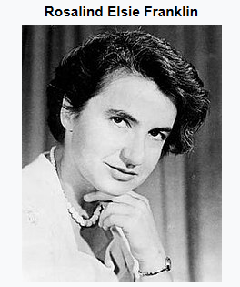
Structure of DNA
Francis Crick
Jonn Watson

Slide 4
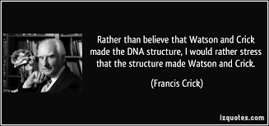
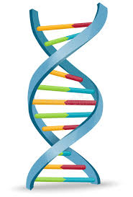

Slide 5
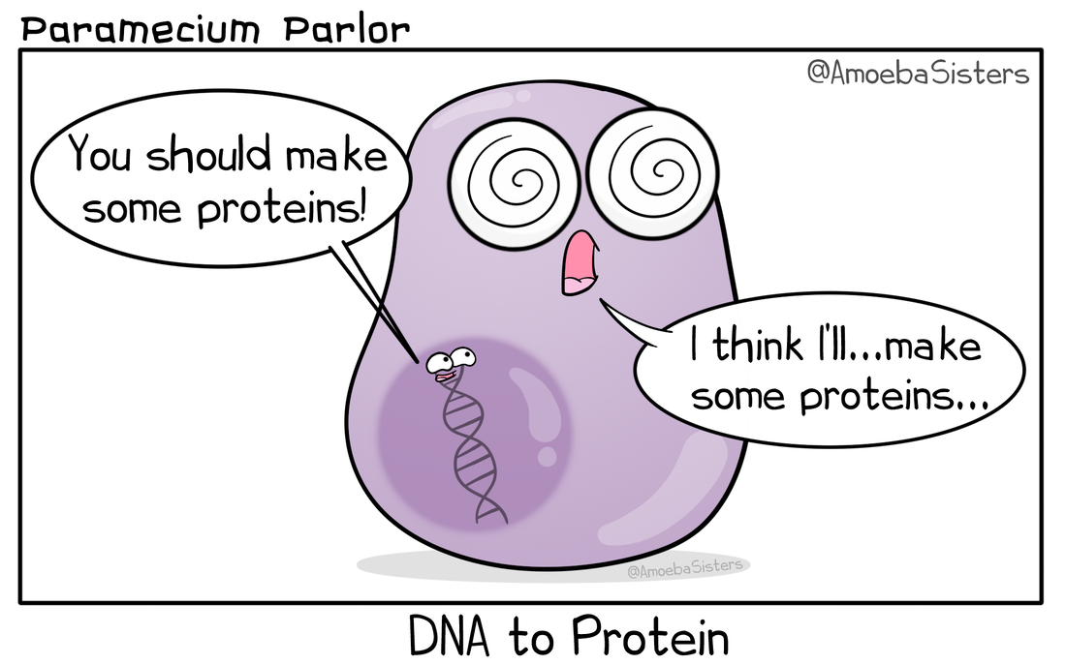

Slide 6
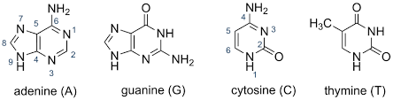
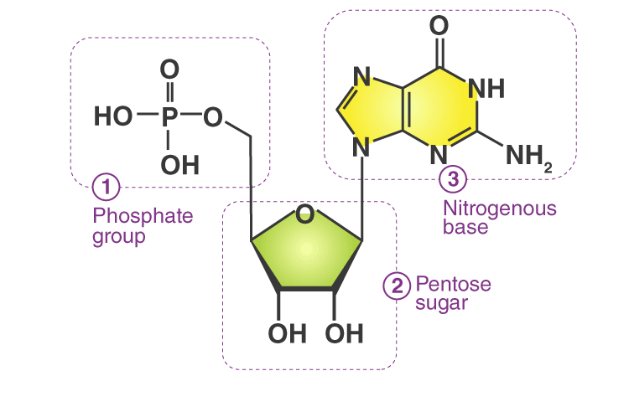

Slide 7
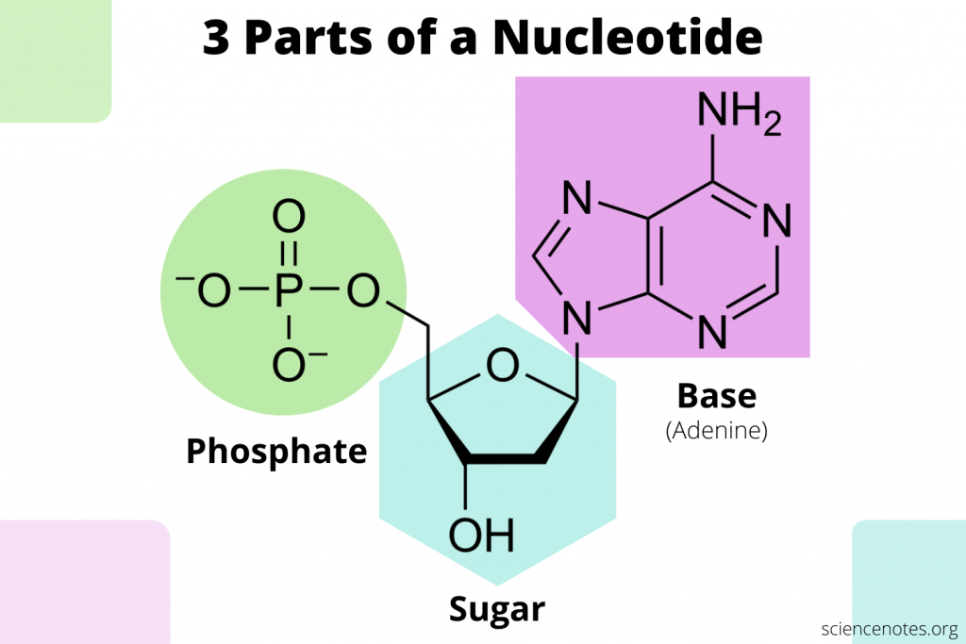

Slide 8
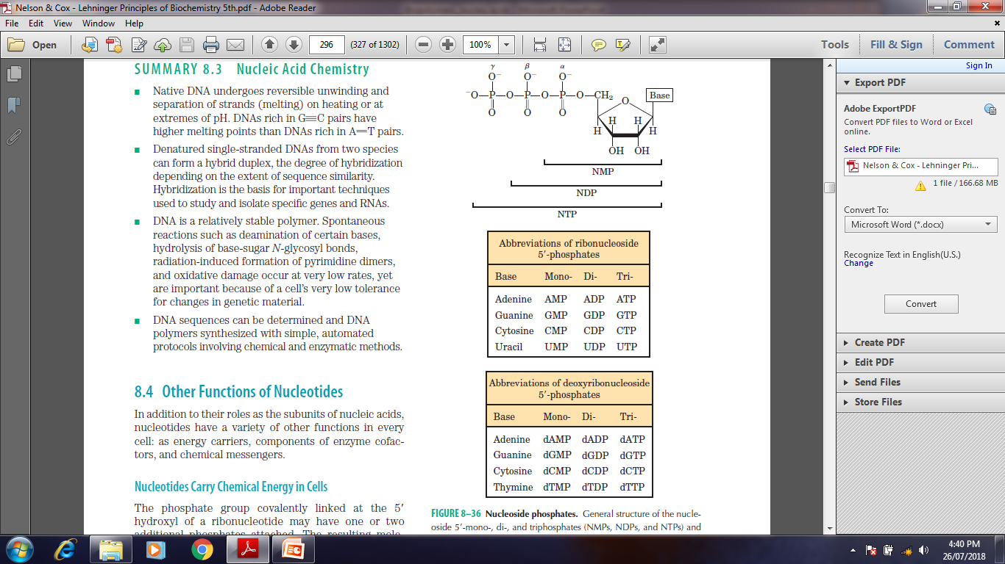
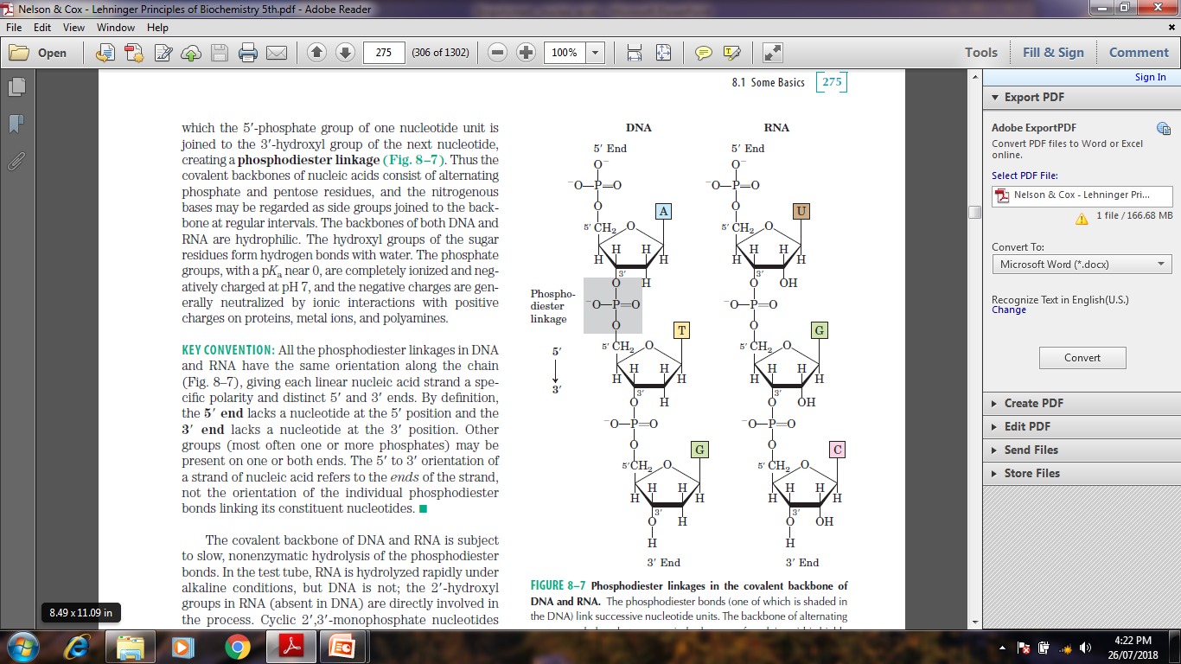
Sugar phosphate back bone

Slide 9
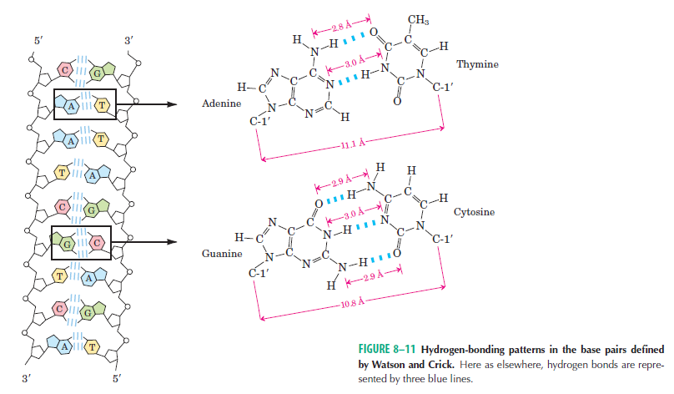
DNA- Base pairing

Slide 10
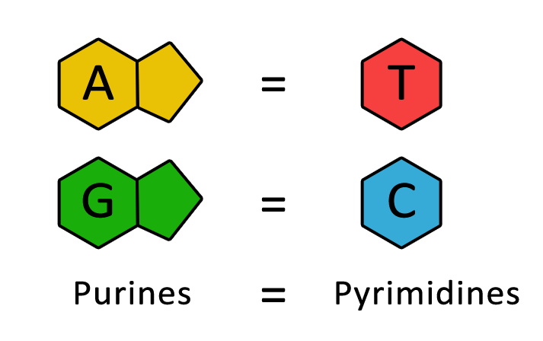
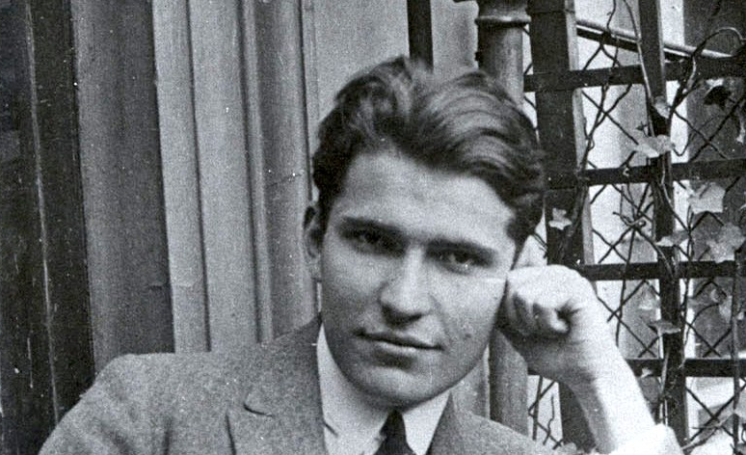
DNA- Base pairing
Chargaff's rules states that DNA from any cell of all organisms should have a 1:1 ratio (base Pair Rule) of pyrimidine and purine bases and, more specifically, that the amount of guanine is equal to cytosine and the amount of adenine is equal to thymine.

Slide 11
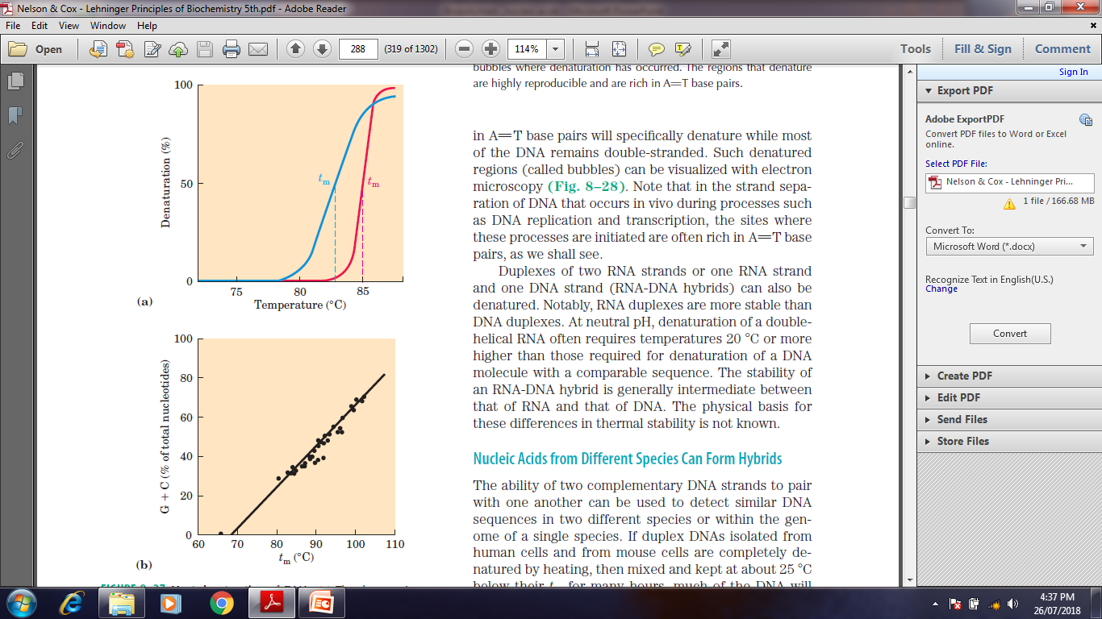
Nuclei acid denaturation

Slide 12
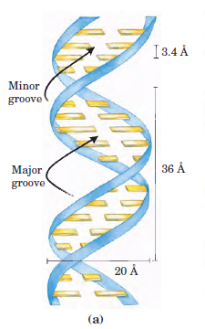
Nuclei acids in solution

Slide 13
Sugar phosphate back bone

Slide 14
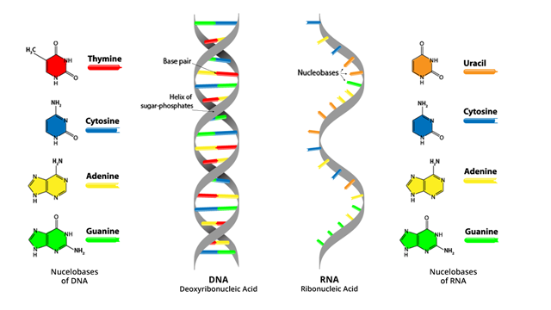
Nuclei acids

Slide 15
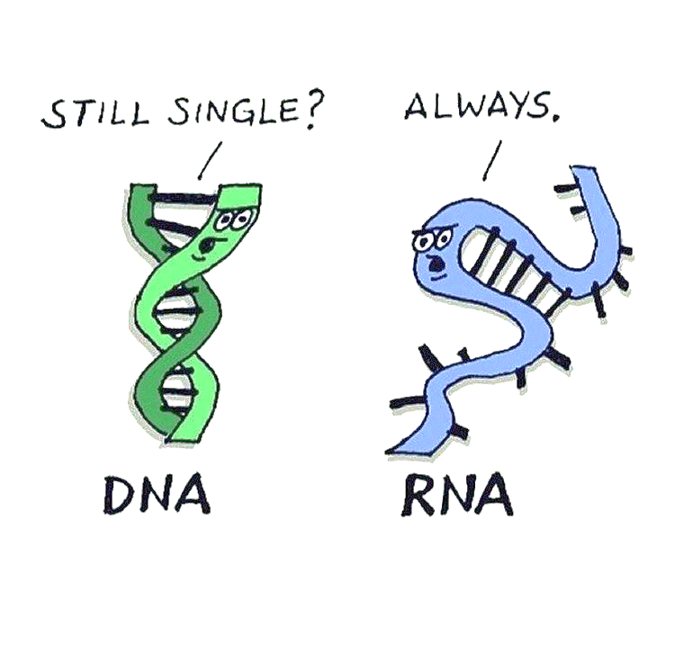

Slide 16
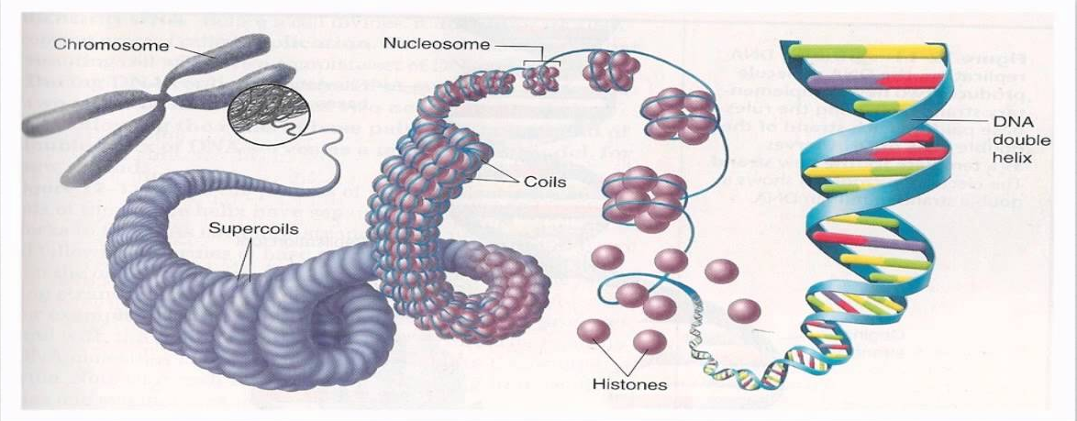
DNA packaging into the nucleus

Slide 17
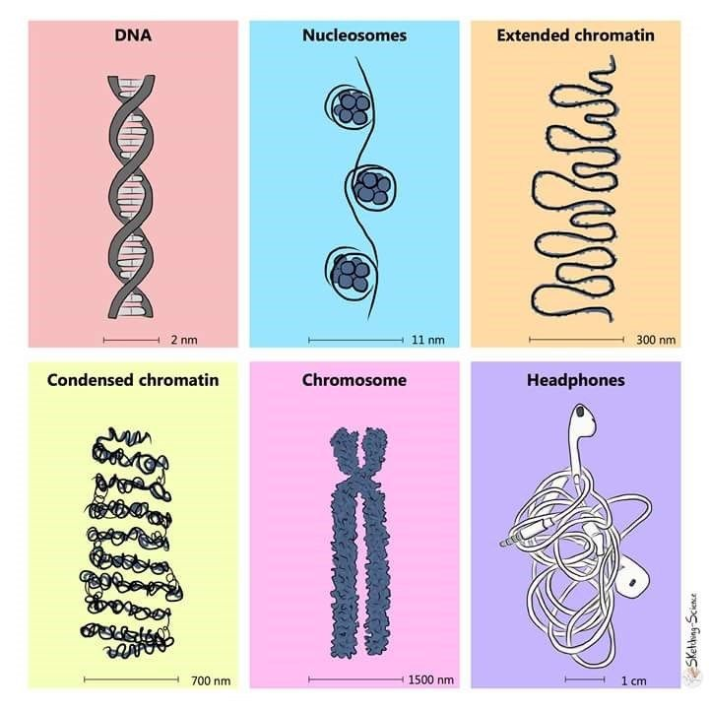

Slide 18
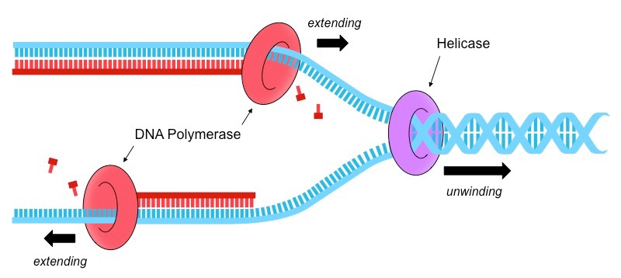
DNA Replication

Slide 19
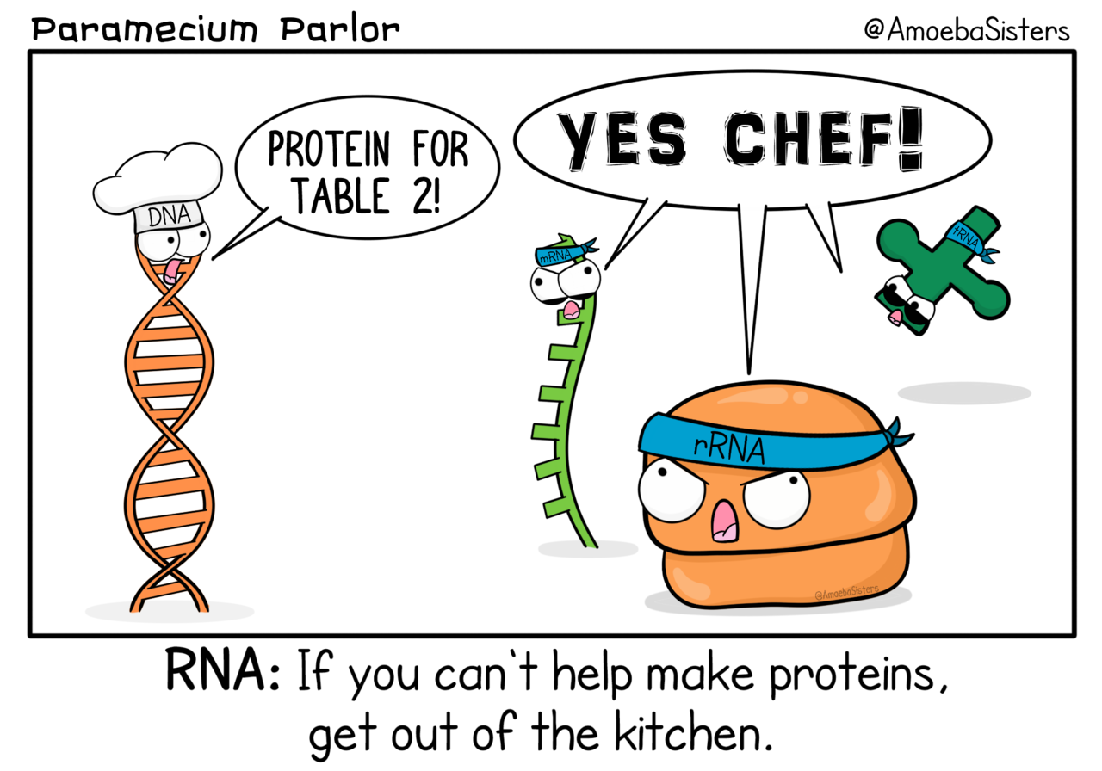

Slide 20
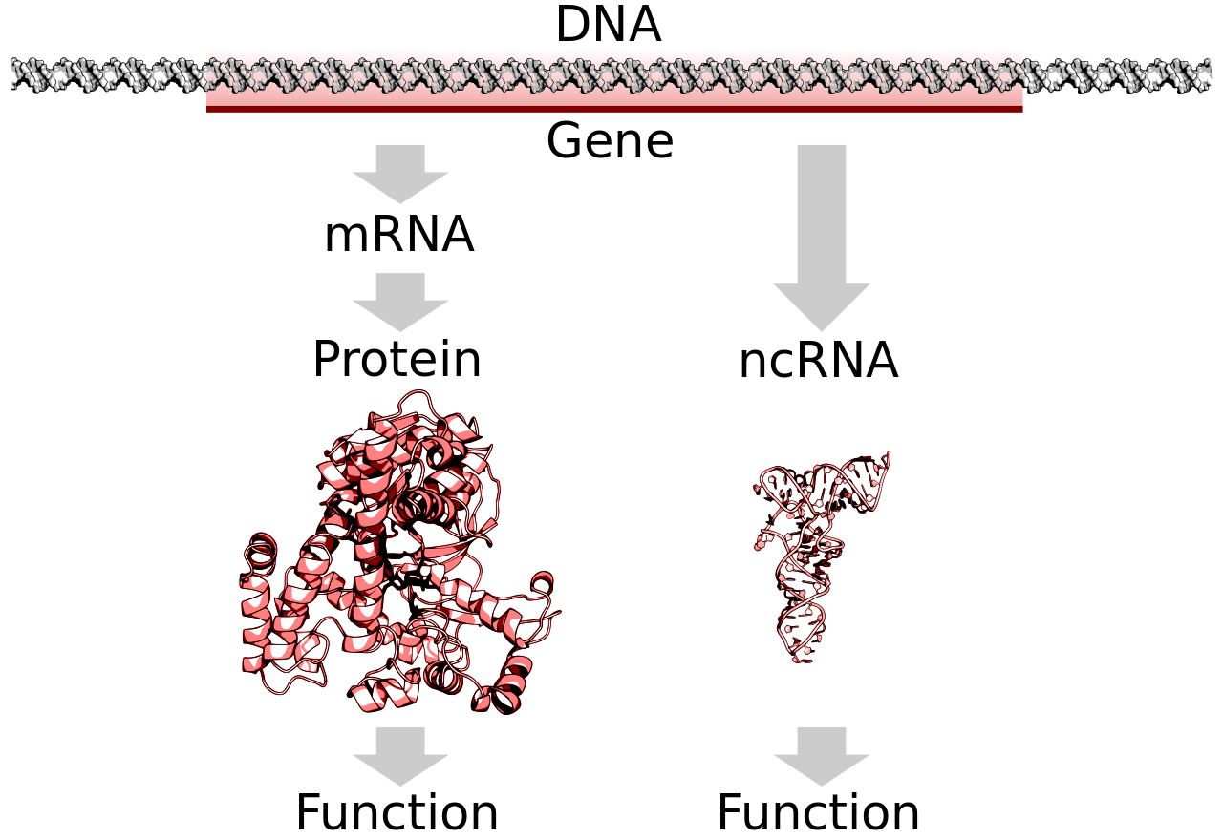
Central dogma

Slide 21
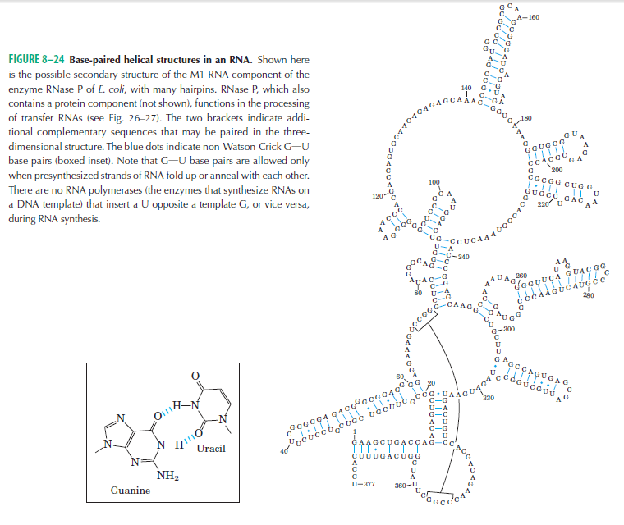
RNA Structure

Slide 22
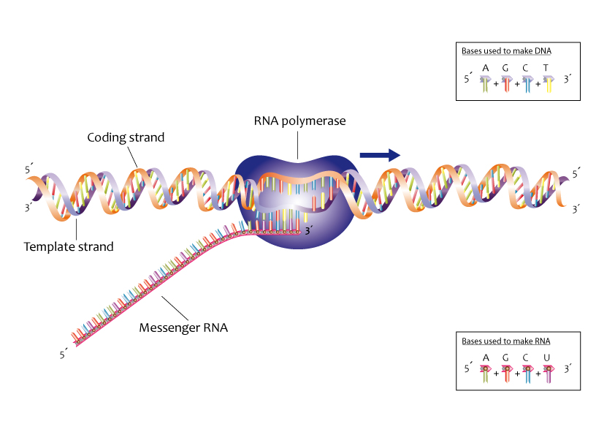
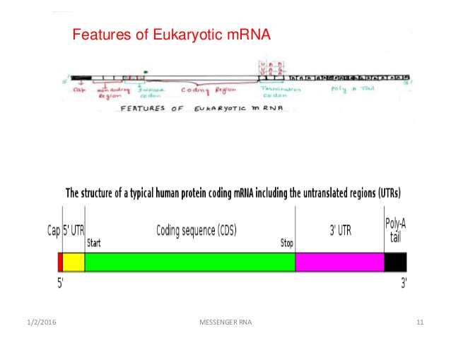
Transcription: process of RNA synthesis

Slide 23
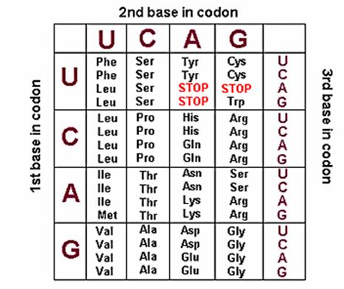
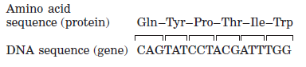
Translation

Slide 24
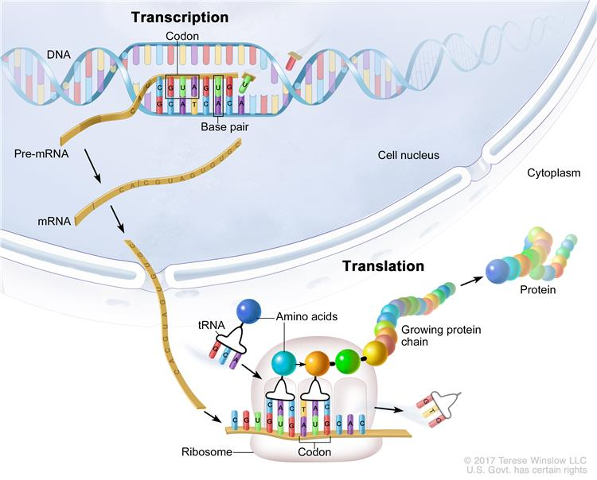
Translation

Slide 25
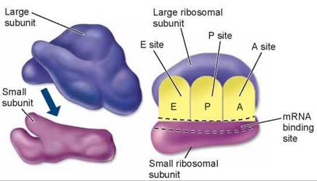
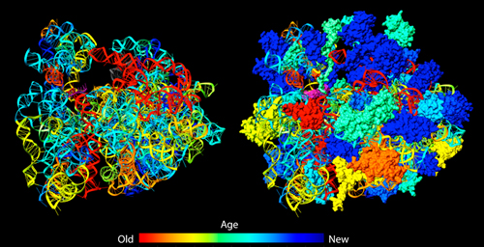
Machinery for Translation: Ribosome

Slide 26
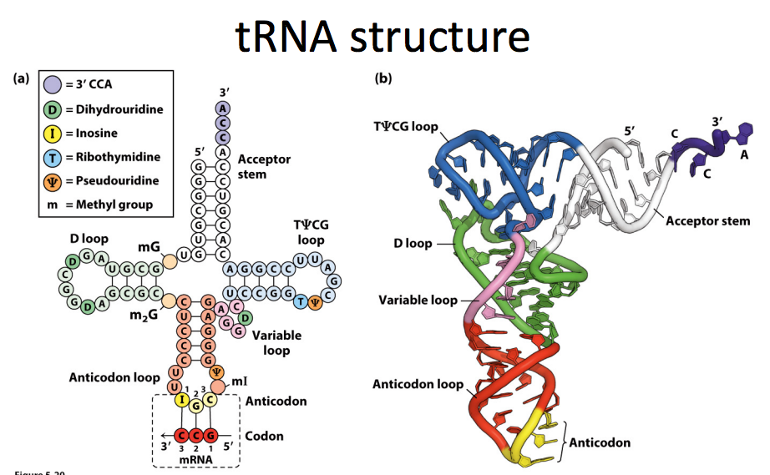

Slide 27
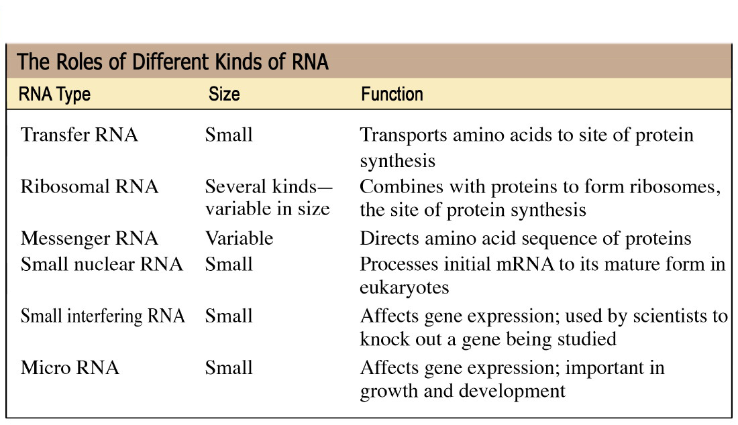
Types of RNA

Slide 28
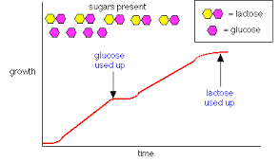
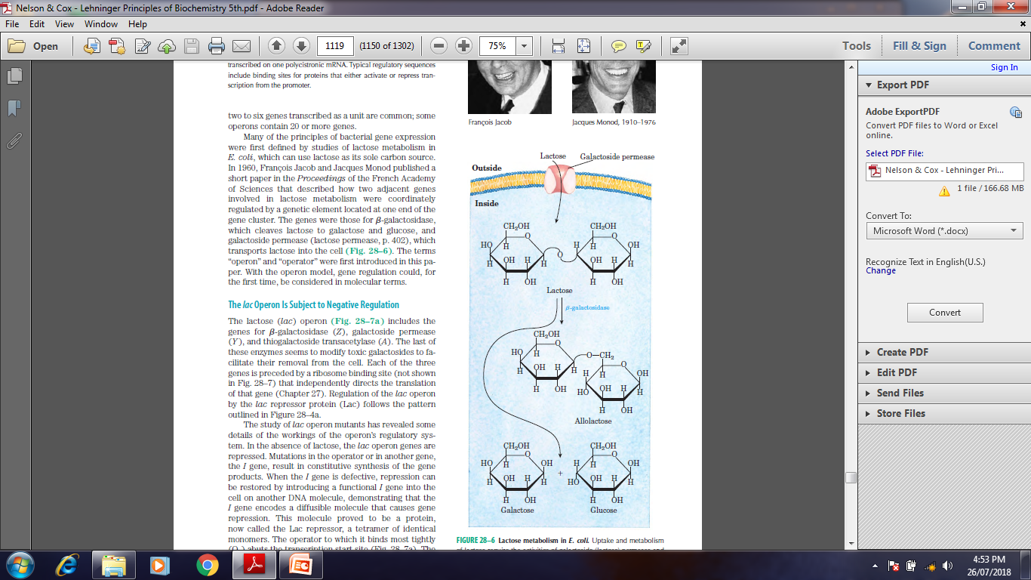
Gene regulation in action

Slide 29
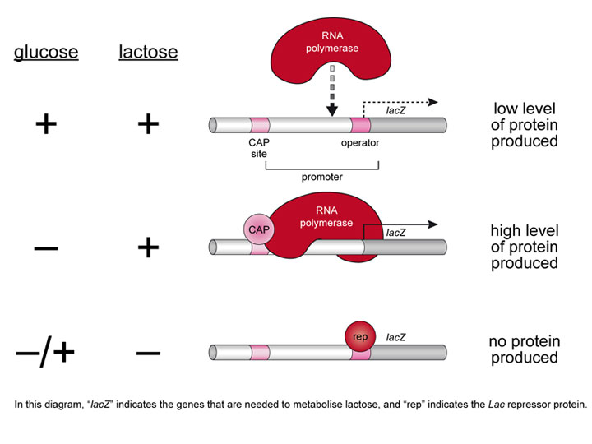
Gene regulation in action

Slide 30
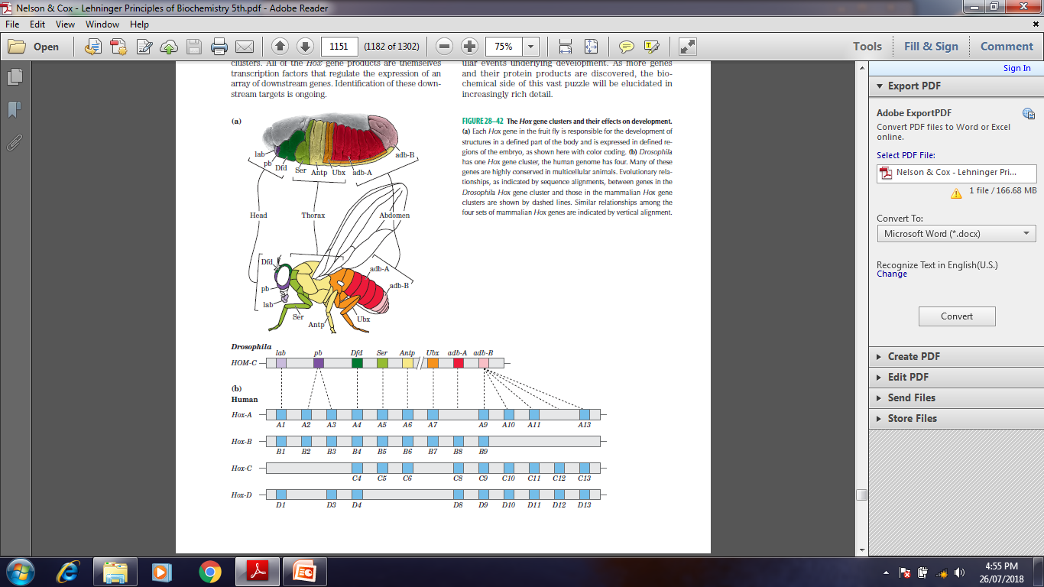
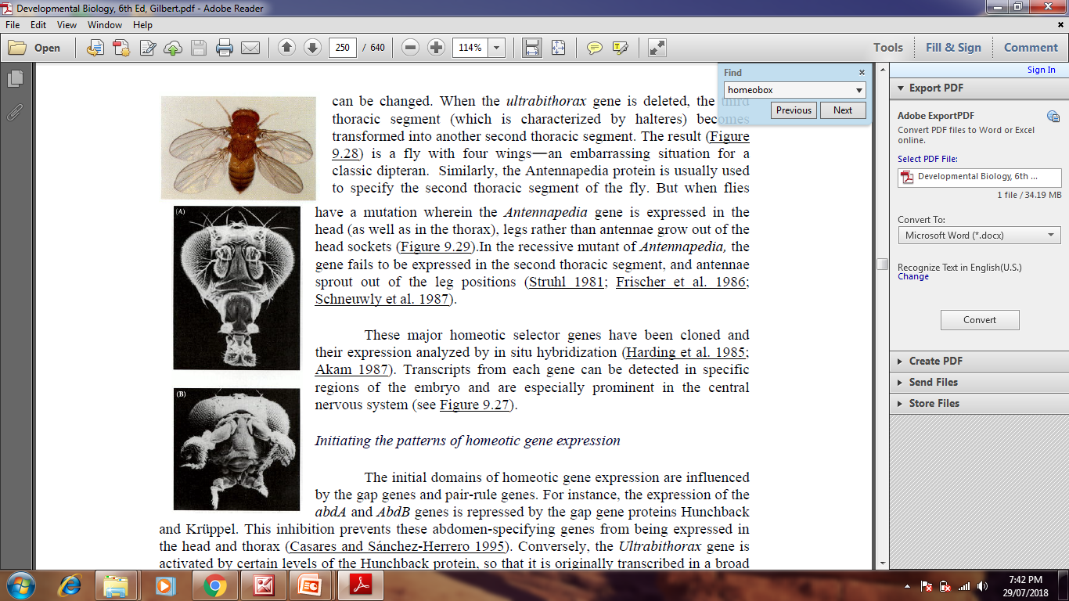
Gene function during development

Slide 31
References:
1. Nelson And Cox, Lehninger Principles of Biochemistry, 6th edition
2. Bioinformatics: Joel Keizer
3. Images: Search engine Google.
4. Harper’s Biochemistry 26th Edition.
5. Genes- VIII, Lewin
6. Developmental Biology by Gilbert 7th Edition

Slide 32
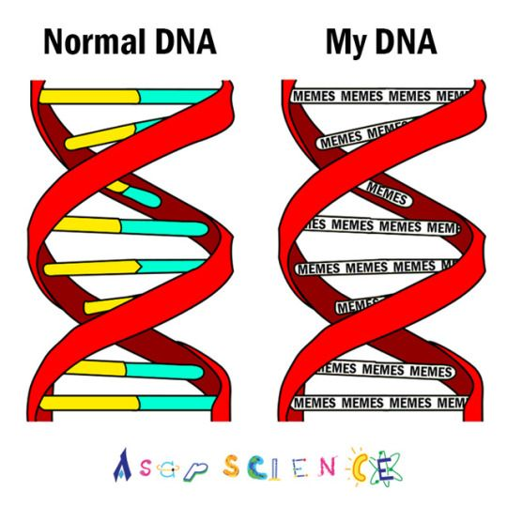

Slide 33
